Slide 1
Achieve Zero Hair Complaints
Protect your Business without Increasing Costs

Slide 2
Achieve Zero Hair Complaints
Protect your Business without Increasing Costs
The White paper written by:
Professor Barry Stephens FTTS, President of the Trichological Society 2014-16
The University of Bolton, England:
Professor Subhash Anand, MBE, Professor of Technical Textiles, Institute for Materials Research and Innovation
Professor Subbiyan Rajendran, Biomedical Textiles
Dr. Karthick Kanchi Govarthanam PhD; MSc; B.Tech; CText ATI
Food Industry professionals from across industry
ABurnet Ltd

Slide 3
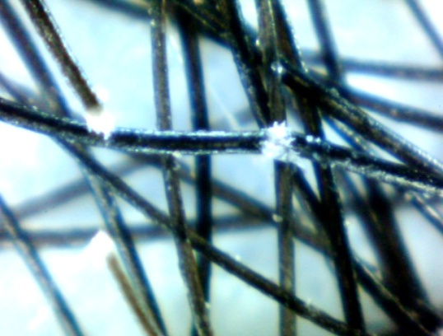
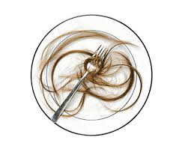
How much Hair is Shed and Why?
Trichorrhexis Nodosa Photo-micrograph x 50 - Copyright B.J.Stevens
The high-spots indicate the points of eventual severance
How many hairs does the average human shed per day? Is this the only issue with hair?
“If we accept that hair-shaft shedding is a constant occurrence it is possible that 13-43 hairs could be shed from the scalp of each employee during an 8 hour period. This equates with 1,300-4,300 hairs per 100 people. These figures can be significantly augmented by thermal injury and severance (following exposure to excessive heat from hairdryers, curling tongs etc) and chemical insult e.g. bleaching, colouring, permanent waving, chemical relaxing or chemical straightening. The figures will be further increased by the daily losses of beard, nasal and ear hairs, eyebrows and eyelashes”.
Source: Professor Barry Stevens, FTTS, President of the Trichological Society 2014-16

Slide 4
Why does Hair Escape Head Coverings?

Slide 5
According to Professor Subhash Anand, MBE, Professor of Technical Textiles, Institute for Materials Research and Innovation, University of Bolton, England, “nonwoven materials, such as those used in mob and bouffant caps should not be used as a hair barrier fabric. Due to the nonwoven manufacturing methods of spinning the fibres, it is impossible to control the alignment and spacing of the fibres leading to a variable fabric structure with inherent gaps and different densities, allowing hairs to protrude through. Due to the fabric’s rigidity, it will neither hold the head of hair nor grip strands of hairs that protrude through the fabric. It is a totally unsuitable material. This is evidenced in our wearer trials which proved that mob caps are the worst form of hair containment caps currently used in the UK food processing industry.”

Slide 6
Where does Hair Protrude Most?

Slide 8
Is Hair a Microbial Risk?
‘’I am unable to eliminate hair-shafts as disease carriers (i.e. Staphylococcus Aureus). However, hand contact with the scalp during food production is probably more likely to act as a carrier therefore complete head hair covering is recommended.
I cannot ignore the potential for contamination via beard hair as this can be an involuntary target of touch by infrequently washed hands. Covering the beard with net is therefore a wise precaution”.
Prof. Barry Stevens FTTS President of The Trichological Society 2014-16

Slide 9
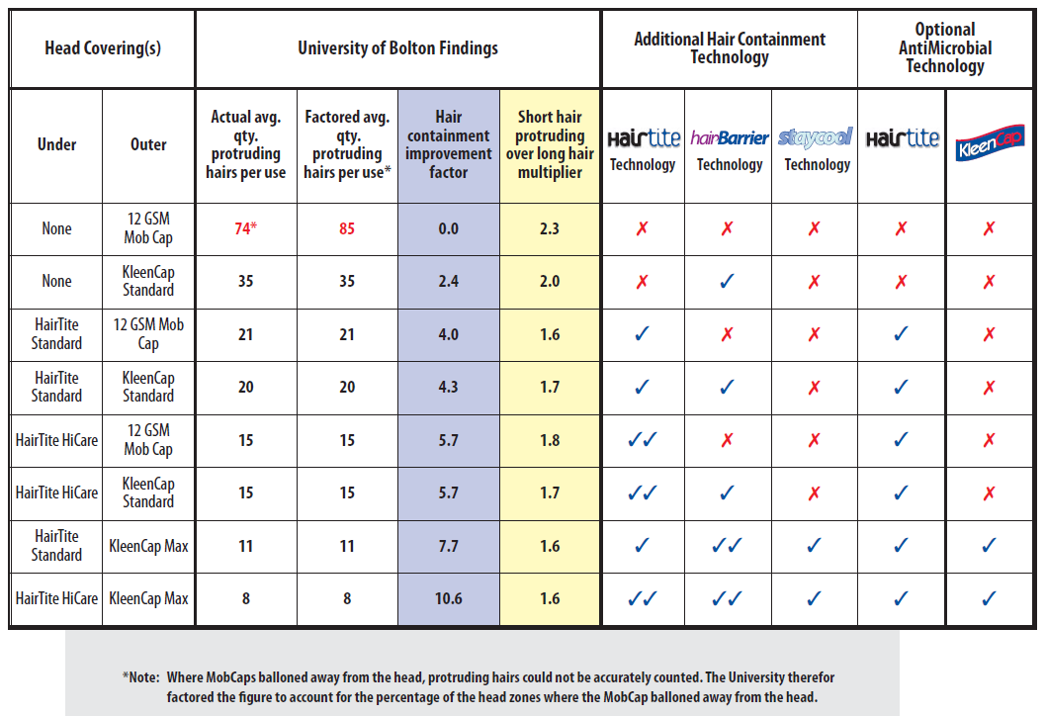
KleenCap Max and HairBarrier products have been independently tested
>99.9%effective at inhibiting the multiplication of Gram positive and Gram Negative bacteria over 15 washes with HairGon- the formula wash additive

Slide 10
Hair Containment Headwear
http://www.aburnet.co.uk/free-tools/ http://www.aburnet.co.uk/target-zero-hair-complaints/

Slide 11
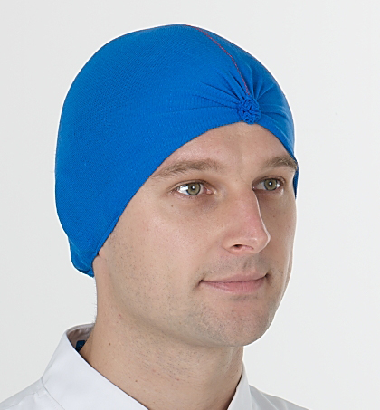
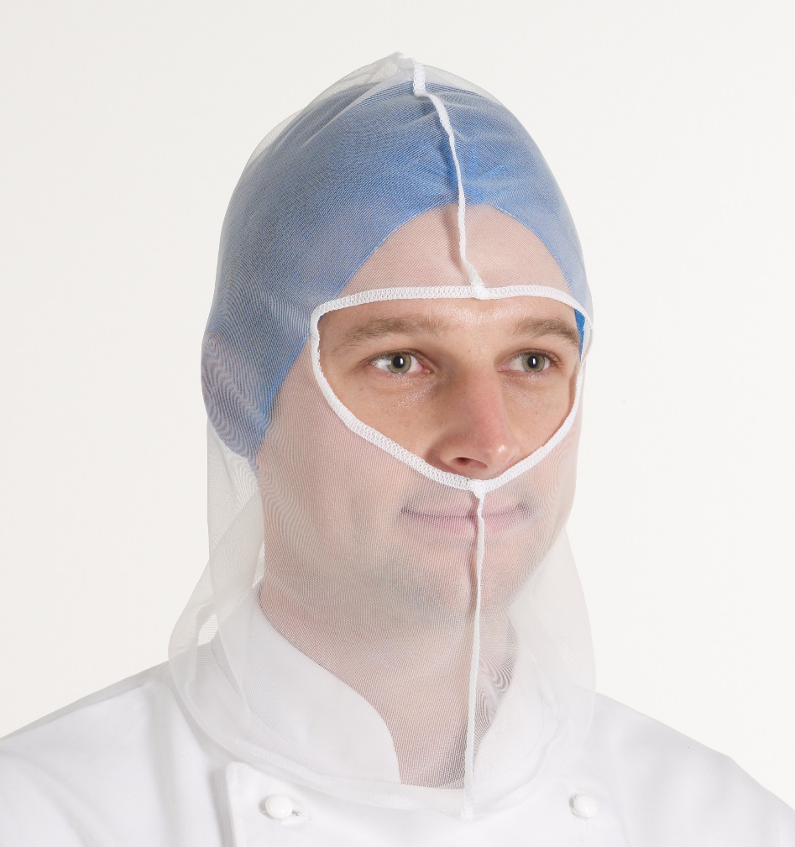
Hairline Security
http://www.aburnet.co.uk/free-tools/ http://www.aburnet.co.uk/target-zero-hair-complaints/

Slide 12
Training

Slide 13
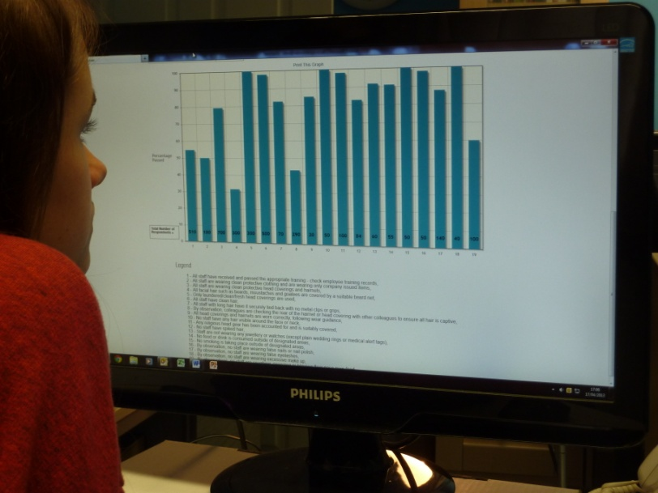
KPI Reporting

Slide 14
Professional Feedback..
Professor Barry Stevens FTTS, Trichologist and President of The Trichological Society 2014-16
“KleenCaps look good; the cap lightly holds the hair and I cannot envisage any hair escaping through the fabric structure. The triple elastic distributes pressure evenly whilst ensuring hair line safety. I understand the StayCool technology is proven to wick moisture away from the head and may regulate the wearer’s temperature”.
“Food production personnel can effectively prevent scalp hair contamination through the wearing of HairTite HygieNets and KleenCap-Max, with HairBarrier products such as Neck Shield – which can be worn in multiple ways to cover beard, face and nasal hair as desired, or Beard Shield, or KleenCap-Max Neck Guard (covering scalp and beard hair) if new each day or cleansed with HairGon after a single day’s wear to remove any residual hair-shafts caught in the material. However eyebrow, eyelid, ear and facial hair cannot be ignored – their prevention being more problematic”
http://www.aburnet.co.uk/free-tools/ http://www.aburnet.co.uk/target-zero-hair-complaints/

Slide 15
Industry Feedback..
“We have trialled KleenCap and the feedback from the operatives is that the KleenCap is very comfortable”.
Michaela Watson, QA/Compliance Manager, Freshtime UK Ltd, England.
“This is a really innovative approach to hair containment and complaint reduction. A choice of hair coverings which are well supported with clear visual aids and a KPI Management system to track improvements by area. A one-stop shop!”
Ann Marie Helmn, Technical Manager, Fox’s Biscuits Batley
2 Sisters Food Group
“The Free audit tools are great to use as it makes audits easy and you can soon find out where the issues are, the reports are great to show the customer to demonstrate that you are being proactive”
Michaela Watson, QA/Compliance Manager
Freshtime UK Ltd, England
http://www.aburnet.co.uk/free-tools/ http://www.aburnet.co.uk/target-zero-hair-complaints/

Slide 16
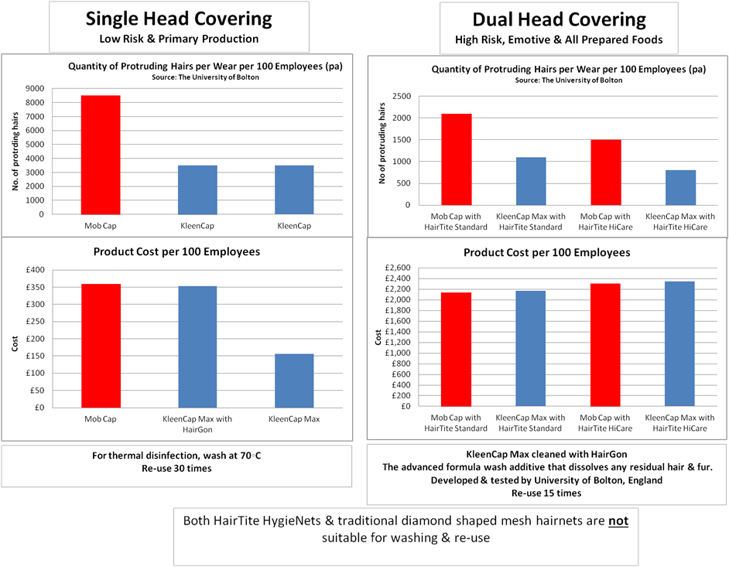
Cost
Comparison

Slide 17
Where do you want to be on the hair containment scale?
Match Products worn to risk category:
Training / Tools
Monitor trends with tools
http://www.aburnet.co.uk/free-tools/ http://www.aburnet.co.uk/target-zero-hair-complaints/

Slide 18
Summary & Next Steps..
Evidence from industry is that we can achieve zero hair complaints – there will always be the odd slip.
We can improve based on scientific understanding as to why hair contamination occurs and how to control it by:
Using performance tested products
Using clear, visual, training materials
Audit and rotate key training messages according to audit findings
Complimentary Information Sources:
Demo of on-line Audit with KPI results at work place –e-mail info@aburnet.co.uk
Download full white paper: www.aburnet.co.uk/target-zero-hair-complaints/
Link FREE HairBarrier Tools – posters, Training Videos & KPI reporting: www.aburnet.co.uk/free-tools/
Samples: Posters / HairTite / KleenCap-Max & other HairBarrier products www.aburnet.co.uk/products/Wear-guides/ & http://www.aburnet.co.uk/products/Hygiene-posters/
Sign up for our free news-letter HairBarrier News
http://www.aburnet.co.uk/free-tools/ http://www.aburnet.co.uk/target-zero-hair-complaints/

